Slide 1


Postgres Administration for Sysadmins
Spencer Christensen
Backcountry.com
PostgreSQL Conference East, Philadelphia
March 26, 2010

Slide 2
PostgreSQL
How do you pronounce “PostgreSQL”?
The Q and L are silent
Notes:
History of Postgres:
Developed at UC Berkely, called Ingres
Academic project
Business Ingres Corp formed
Forks: Informix, Sybase
Then creator decided on different implimentation: Postgres
Postgres95 (1994-1995)
SQL became popular/standard
PostgreSQL (1996-now)

Slide 3
How do you pronounce Thule?
“Yakima”

Slide 4
Audience
Linux/Unix system administrator
Familiar with databases
Want to understand Postgres better

Slide 5
What we'll cover
Management
Monitoring

Slide 6
What we'll cover
Management
  Creating a cluster
  Highlights of postgresql.conf
  Logging options, review of log output
  pg_hba.conf
  Starting, stopping, restarts
  Connecting with psql

Slide 7
What we'll cover
Monitoring
  top
  ps
  du
  pgtop
  pg_top
  check_postgres.pl
  Pgfouine

Slide 8
Management
Install by rpm/deb/source
Multiple installs
Multiple instances (different ports, different ip addresses, etc)

Slide 9
Creating a cluster
Initdb -D /path/to/data/dir [options]
  -U postgres
[schristensen@small_db ~]$ initdb -U postgres -D cluster1/data
The files belonging to this database system will be owned by user "schristensen".
This user must also own the server process.
The database cluster will be initialized with locale en_US.UTF-8.
The default database encoding has accordingly been set to UTF8.
The default text search configuration will be set to "english".

Slide 10
Postgresql.conf
Located at $PGDATA/postgresql.conf
Helpful comments
Default values commented out
Some changes require a restart (others can be picked up with a reload)

Slide 11
Postgresql.conf
port = 5432
listen_addresses = 'localhost'
max_connections = 10
statement_timeout = 0 # microseconds

Slide 12
Postgresql.conf
port = 5432
  port = 54321
listen_addresses = 'localhost'
  listen_addresses = '*'
max_connections = 10
  max_connections = 100
statement_timeout = 0 # microseconds
  statement_timeout = 1800000

Slide 13
pg_ctl
pg_ctl -D /path/to/data/dir \
-l /path/to/logfile [start|stop|reload|restart|status]
Run as owner of data files (created by initdb)
-m [smart|fast|immediate] stop
Start cluster1

Slide 14
Logging options
log_destination = 'stderr' # or syslog
log_directory = 'pg_log'
syslog_facility = 'LOCAL0'
log_connections = off
log_disconnections = off
log_duration = off
log_statement = 'none' # or all, ddl, mod

Slide 15
Log output samples
LOG: connection received: host=192.168.56.1 port=44738
LOG: connection authorized: user=training database=training
LOG: duration: 18.301 ms
LOG: duration: 0.898 ms
LOG: duration: 1428.301 ms
LOG: duration: 2038.301 ms
LOG: disconnection: session time: 0:00:12.543 user=training database=training host=192.168.56.1 port=44738

Slide 16
Log output samples
LOG: connection received: host=192.168.56.1 port=33185
LOG: duration: 23.469 ms
LOG: connection authorized: user=training database=training
LOG: statement: select * from emusic.sales_item
LOG: duration: 0.706 ms
LOG: statement: select * from emusic.stores
LOG: duration: 0.447 ms
LOG: disconnection: session time: 0:00:12.084 user=training database=training host=192.168.56.1 port=33185

Slide 17
pg_hba.conf
HOST DATABASE USER CIDR-ADDRESS METHOD [OPTION]
local all pgmonitor trust
host all all 10.41.8.21/32 md5
host all all 10.12.12.0/24 md5
Need to reload to take effect
H

Slide 18
Postgres Env vars
$PGDATA – data directory
$PGPORT – port
$PGHOST – host
$PGUSER – user
pg_ctl -l /tmp/pg.log start
psql

Slide 19
psql
psql [-h $host] [-p $port] [-U $user] $db
\d – list tables, views, sequences
\dt – list tables only
\d my_awesome_table – describe table, view
\q – exit out of psql
\l – list databases in cluster
\du – list users in cluster
\h – help

Slide 20
Monitoring

Slide 21
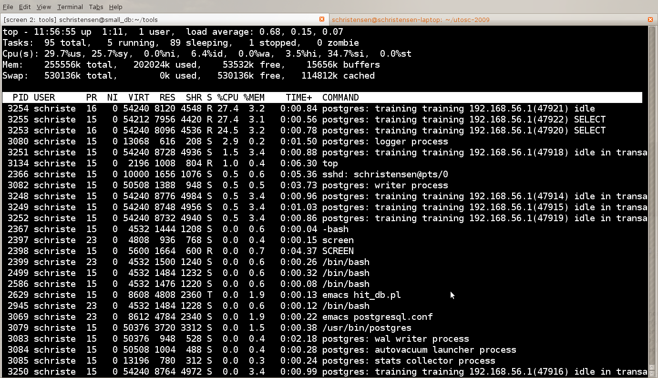
top
Example of running queries
Notes:
Top line output for postgres:
User, database, host connected from, PID, command type

Slide 22
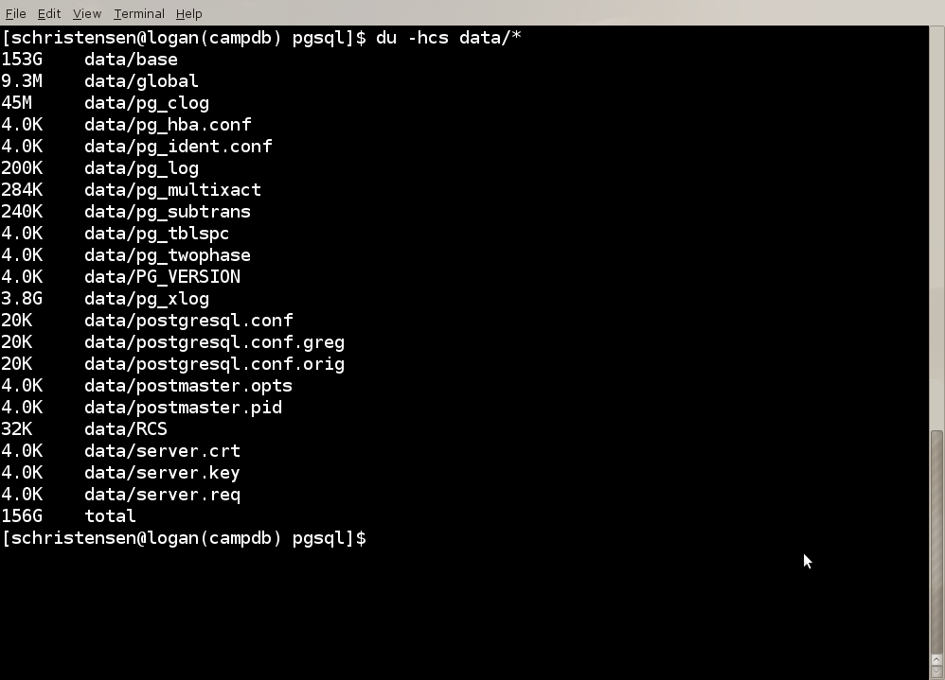
Du
Example of disk space usage

Slide 23
Pgtop
http://search.cpan.org/~cosimo/pgtop-0.05/pgtop
Based on mytop
Example of running pgtop

Slide 24
pg_top
http://ptop.projects.postgresql.org/
More like system top
  Can view running queries, locks, EXPLAIN
Example of running pg_top

Slide 25
check_postgres.pl
http://bucardo.org/check_postgres/
Disk space
Backends
Index size
Table size
Bloat
Last vacuum
Locks
txn_wraparound

Slide 26
Pgfouine
http://pgfouine.projects.postgresql.org/
Log files
  Connections, disconnections, durations, statements
Vacuum verbose output
Example

Slide 27
Wrap up
Initdb, postgresql.conf, pg_hba.conf
pg_ctl -D $datadir start|stop|reload|status
psql
Top, du
pg_top, pgtop
check_postgres.pl
Pgfouine

Slide 28
Me
Spencer Christensen
Backcountry.com
schristensen@backcountry.com
email@spencerchristensen.com

